Slide 1
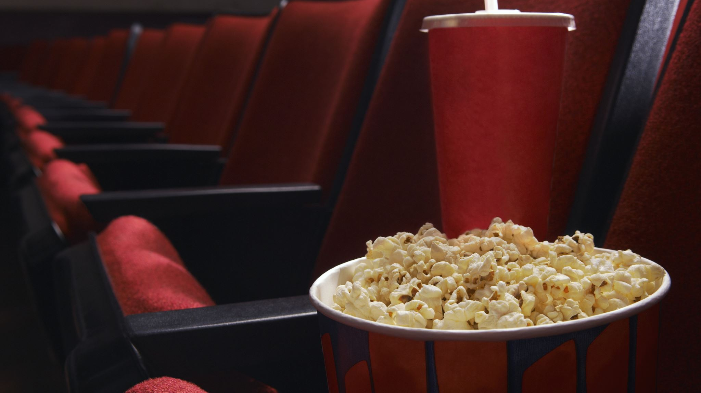
Data analysis on TMBD Movies
By : G S Kaushik
Guided By : Aakansha Gupta

Slide 2
Introduction
Hollywood stands as one of the most lucrative businesses, producing hundreds of movies annually with substantial funding involved.
The success or failure of a movie relies on factors beyond financial investment, including the selection of stars, crew, and various contributors.
This project aims to analyze a movie dataset, applying Machine Learning algorithms to predict ratings and revenue, categorize genres, and optimize groups for top-rated films.

Slide 3
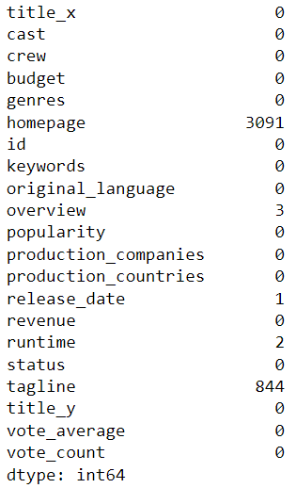
Data Set Description
There are 2 different data sets containing credits and movies having 4803 rows each with 4 columns in credit and 18 columns in movie data set.
Some of the columns like crew, cast etc. are in JSON format.
There are 3091 null value in homepage column and 844 null value in tagline column. And there are few others null value which can be handled.

Slide 4
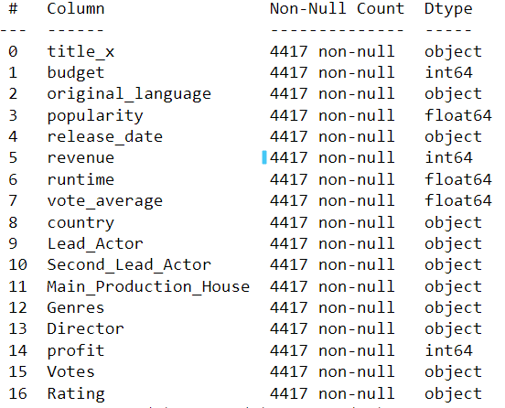
DATA prepossessing
Concatenating 2 different table to one single table.
Extract the important features from the JSON columns, for visualization.
Dropped Unique values in rows and JSON columns in the dataset.
Dropped duplicate values from the rows.
Replaced null value with median or dropped as per the column.
Segregated the columns into categorical and numerical type so that it can be used in EDA.
There are outliers present in data which are not errors.
Created new column profit with the help of budget and revenue column.
Created bins for vote count and average vote and created new column Votes and Ratings for analysis and dropped vote count and average vote column.

Slide 5
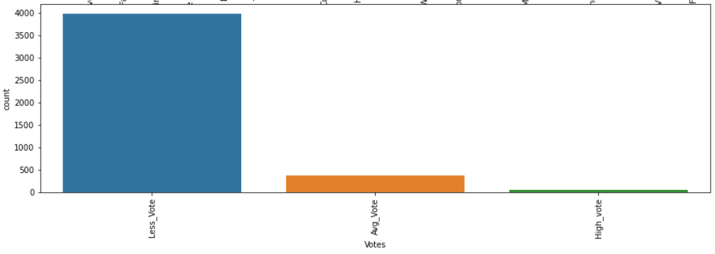
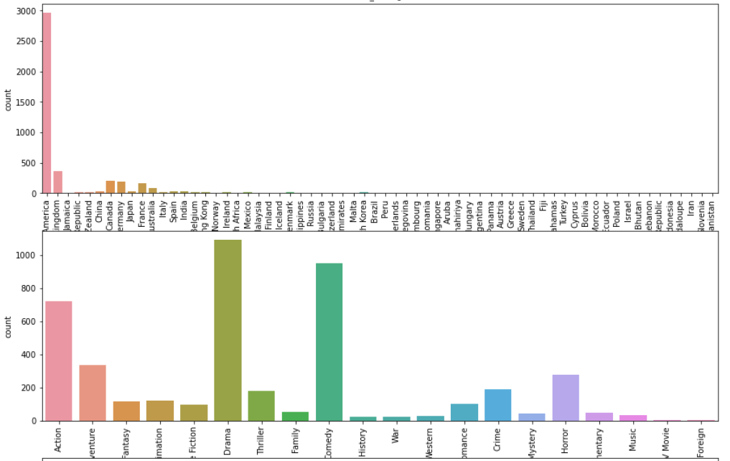
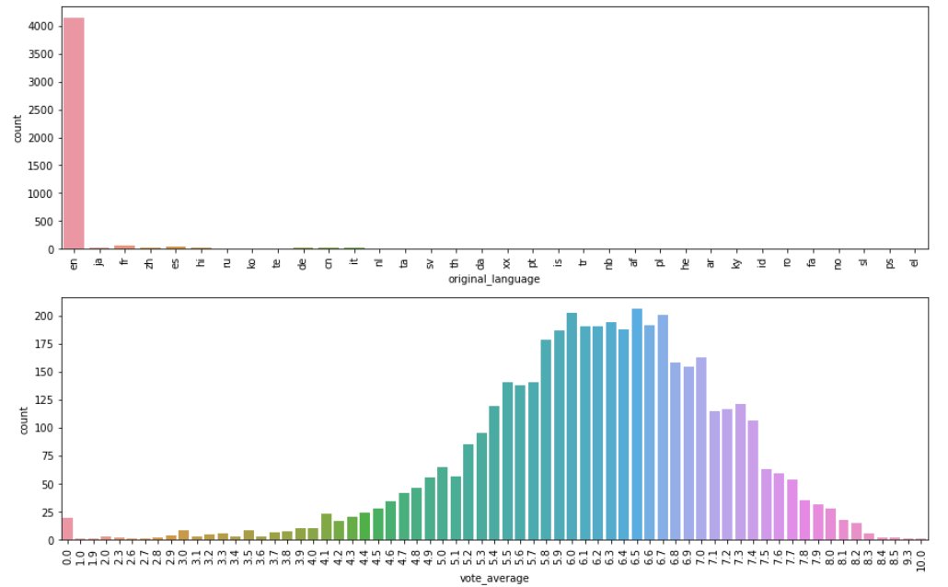
CATEGORICAL DATA EDA - UNIVARAINT
There is monopoly of english language in TMBD Data set.
Most of the movie's rating lies between 5.9 to 7 ratings.
Most of the movies are produced in US.
Drama and comedy movies are listed large number in this data set.
Most of the movies lies in less voted category.

Slide 6
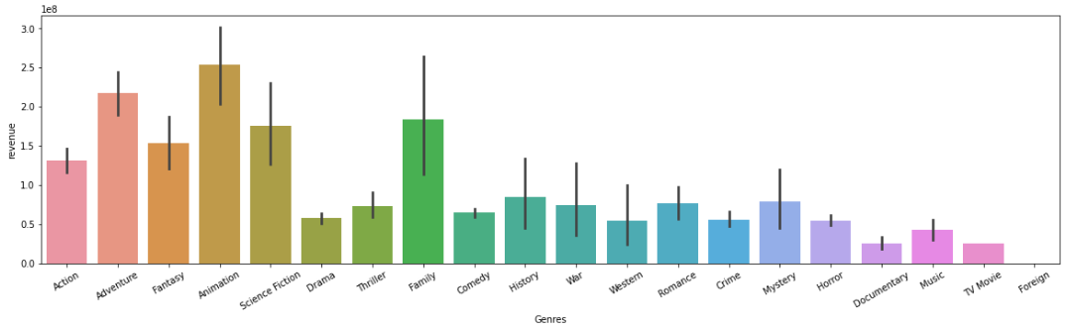
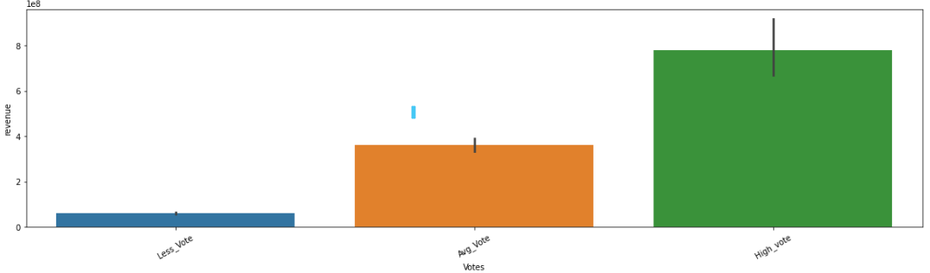
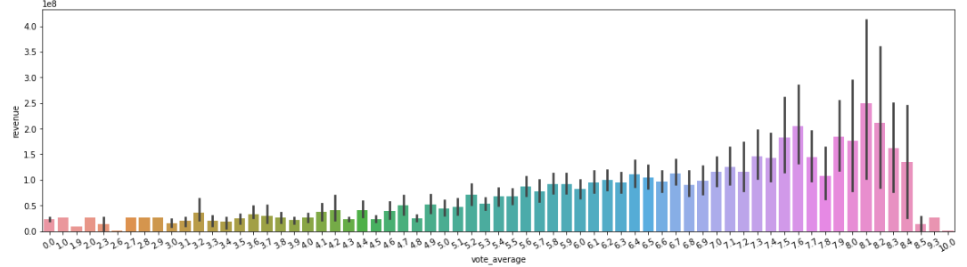
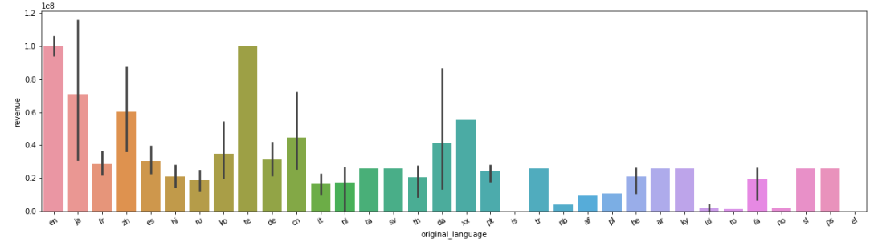
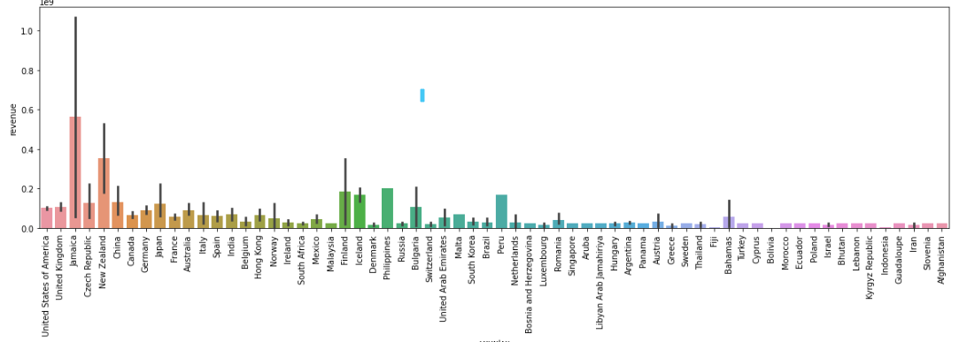
CATEGORICAL DATA EDA - bivariant
Movie produced in te language returns high revenue in box office.
Movie with rating 7.9 to 8.4 gives highest revenue in the box office.
In Jamika, the box office collection the highest.
Animation movie gives highest revenue to the production company.
Highest voted movies has earned highest revenue.

Slide 7
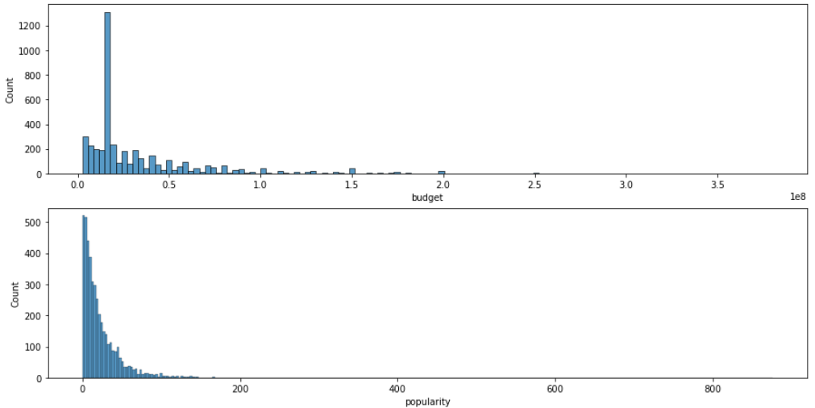
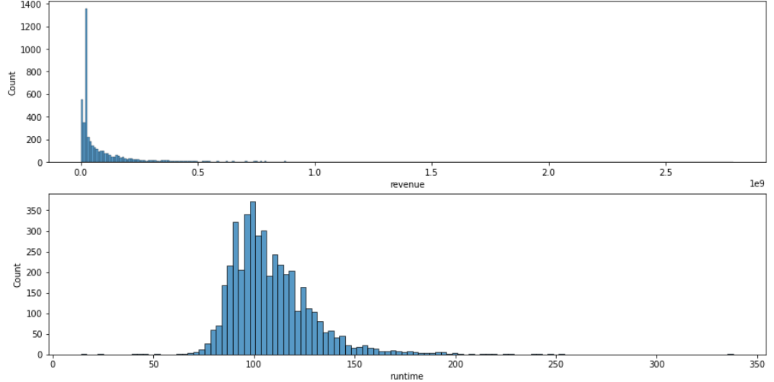
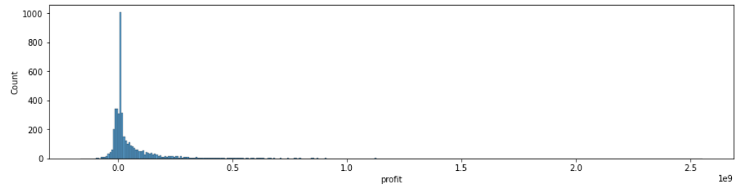
NUMERICAL DATA EDA - Univariant
Budget are in crores most of the movie lies below the 0.5cr bracket.
Most of the movies are less popular.
Revenue earned by most of the movie is bellow 0.25cr.
Runtime of the movie lies between 90min to 120min.
Most of the movie lies in nor profit no loss list.

Slide 8
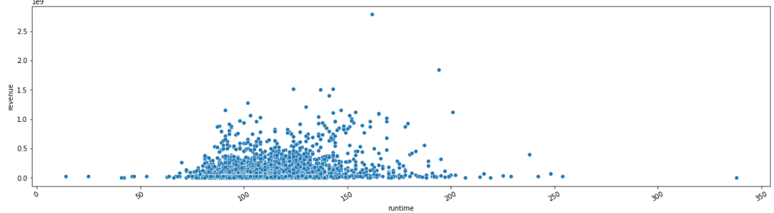
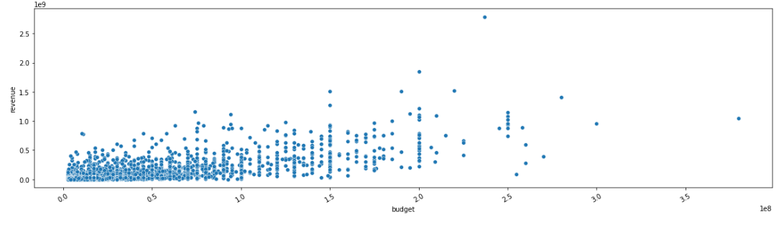
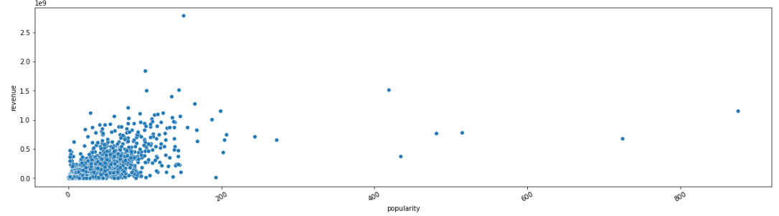
NUMERICAL DATA EDA - Bivariant
When the budget is low the revenue of the movie is also low in most of the cases.
Less popular movie has earned low revenue.
Movies with average runtime has earned more revenue than the long movies and short movies.

Slide 9
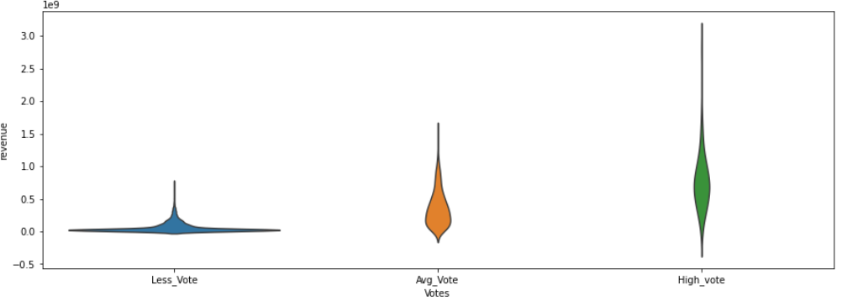
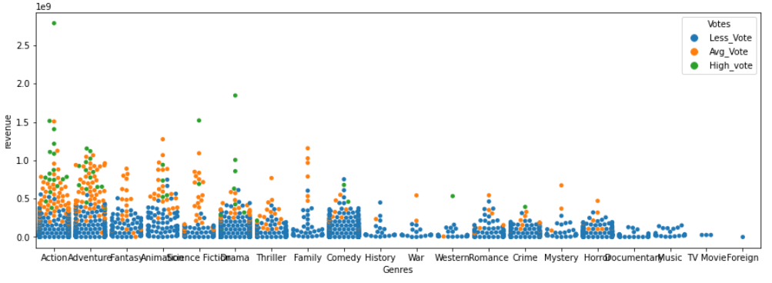
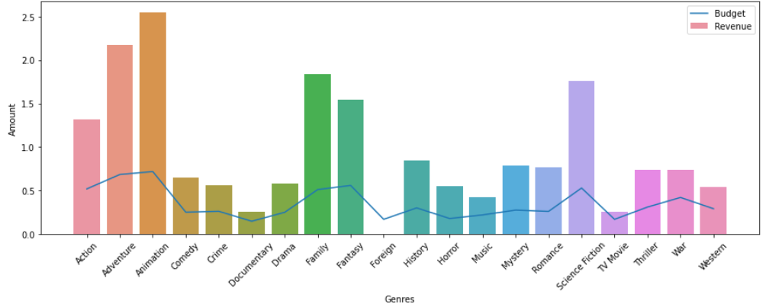
Multivariant Analysis
There are a greater number of movies in less vote the spread is wide, and the revenue generated by movie is also less.
There are approximately good amount of movie in avg_vote the with is not so wide nor so steep and revenue received is also good.
There are less movie in high vote and the revenue received is also high.
Action, Adventure, Drama movies are highest rated. Mainly action movie gives the highest revenue in the box office.
Animation movie budget is less but the profit earned is high.

Slide 10
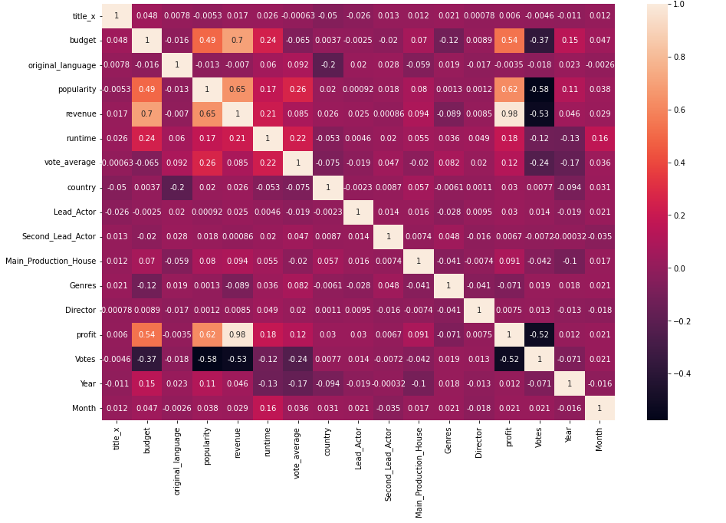
Data Preprocessing
Label encoded the data using LabelEncoder.
Scaled the data by using Minmax scalar for supervised learning and Standard Scaler with normalization in unsupervised learning modules.
To understand visually, took help of heatmap to find the correlation between the features.
Dropped the columns with highly corelated value.
Reduced the dimensions of the data using PCA in unsupervised learning.
Resampling target column using SMOTE technique in supervised classification model.

Slide 11
Classification model Target-Rating
Performance Matrix | Logistic Regression | Naïve Bayes | Decision Tree | Random Forest | Stacking | KNN
Train Score | 0.65 | 0.54 | 0.86 | 0.84 | 0.88 | 0.86
Test Score | 0.64 | 0.52 | 0.75 | 0.79 | 0.82 | 0.72
Accuracy | 0.64 | 0.52 | 0.76 | 0.80 | 0.83 | 0.73
Precision | 0.65 | 0.59 | 0.72 | 0.78 | 0.82 | 0.74
Recall | 0.65 | 0.53 | 0.72 | 0.79 | 0.82 | 0.73
In classification model taking rating as target column stacking gives good result.

Slide 12
Classification model Target-genre
Performance Matrix | Logistic Regression | Naïve Bayes | Decision Tree | Random Forest | Boosting | KNN | Stacking
Train Score | 0.27 | 0.16 | 0.55 | 0.70 | 0.25 | 0.94 | 0.86
Test Score | 0.27 | 0.17 | 0.46 | 0.61 | 0.26 | 0.83 | 0.80
Accuracy | 0.27 | 0.17 | 0.46 | 0.62 | 0.26 | 0.83 | 0.80
Pression | 0.23 | 0.25 | 0.45 | 0.58 | 0.25 | 0.81 | 0.77
Recall | 0.26 | 0.16 | 0.45 | 0.61 | 0.24 | 0.83 | 0.79
In classification model taking genre as target column KNN gives good result.

Slide 13
Regression model Target-revenue
Performance matrix | Linear Regression | Decision Tree | Random Forest | Boosting | Stacking
R2 Train | 0.64 | 0.76 | 0.74 | 0.72 | 0.74
R2 Test | 0.66 | 0.61 | 0.72 | 0.68 | 0.72
RMSE | 92005680.56 | 99933517.42 | 84492642.56 | 90774979.82 | 84113688.84
MAE | 51829911.11 | 54018916.92 | 46383939.45 | 52843876.44 | 47013250.70
MAPE | 813.09 | 2462.96 | 2459.99 | 3947.91 | 1708.55
In regression model with revenue as target column stacking and random forest gives good scores but stacking has less error compared to random forest.

Slide 14
Cluster model
Performance Matrix | Silhouette Score
K-Mean | 0.38
Hierarchical Clustering {Agglomerative Clustering} | 0.26
DBSCAN | -0.30
In this clustering model K-Mean gives good result.

Slide 15
Factors affecting rating
The TMDB movie dataset highlights the characteristics of Good Rated movies:
Higher profitability
Higher revenue
Higher popularity
Higher budgets
Higher concentration of drama genre
Often released towards the end of the year
On the other hand, Average Rated movies exhibit:
Predominantly released at the beginning of the year
Comedy and action genres are the most prevalent

Slide 16
Conclusion
The TMDB movie dataset has not only shed light on the factors contributing to movie success but has also highlighted the effectiveness of specific machine learning techniques.
K-nearest neighbors (KNN) and stacked models excel in supervised learning, with KNN capturing local patterns and stacked models combining model strengths for superior predictive accuracy.
On the other hand, k-means clustering has emerged as a valuable technique in unsupervised learning, allowing us to uncover valuable patterns and insights within the TMDB movie dataset.

Slide 17

Thank you

